Slide 1
John Adams’
Presidency
1797-1801

Slide 2
Irony?
“There is nothing which I dread so much as a division of the republic into two great parties, each arranged under its leader, and concerting measures in opposition to each other. This, in my humble apprehension, is to be dreaded as the greatest political evil under our Constitution.” ― John Adams

Slide 3
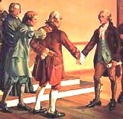
Election of 1796 Issues in the Young Nation
Federalists and Democratic-Republicans aren't speaking to each other.
End of the One-Party System
http://www.james.com/beaumont/images/smith_melancton1.jpg

Slide 4
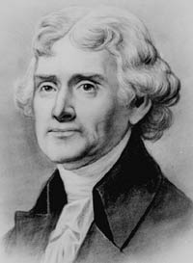
Election of 1796 The Potential Candidates
Jefferson was the only Democratic-Republican candidate.
Thomas Jefferson
http://www.writespirit.net/authors/thomas_jefferson/Thomas-Jefferson-Pic.jpg

Slide 5
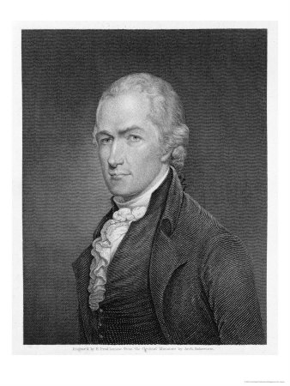
Election of 1796 The Potential Candidates
Hamilton would have run for the Federalists, but constitutional issues and his financial reforms would lead to a loss for the Federalists.
Alexander Hamilton
http://imagecache2.allposters.com/images/pic/BRGPOD/187255~Alexander-Hamilton-Posters.jpg

Slide 6
Election of 1796 The Potential Candidates
Thomas Pinckney was Hamilton's choice to run. Could control him.
Thomas Pinckney
http://etc.usf.edu/clipart/1300/1345/Pinckney_2_th.gif

Slide 7
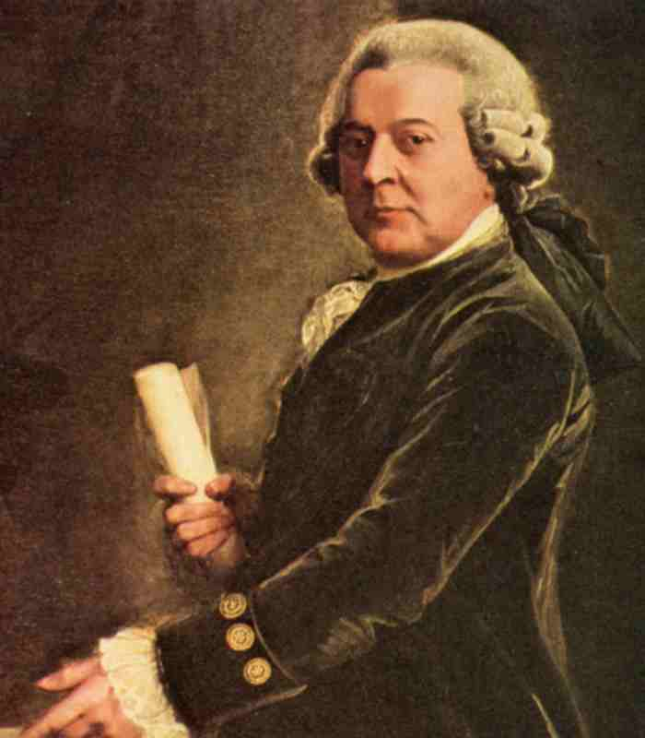
Election of 1796 The Potential Candidates
Final candidate was the Vice-President, John Adams, who was also a Federalist, but more strong-minded.
John Adams
http://www.tamut.edu/academics/mperri/AmSoInHis/John-Adams.jpg

Slide 8
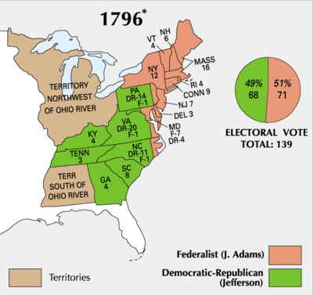
Election of 1796 Results in the Electoral College
Adams 71, Jefferson 68, and Pinckney 59.
Jefferson is Vice-President.
Adams has lost trust in Hamilton and Pinckney.
1796 Election Results
http://upload.wikimedia.org/wikipedia/commons/thumb/5/57/ElectoralCollege1796-Large.png/400px-ElectoralCollege1796-Large.png

Slide 9
XYZ Affair Origins
The "Quasi-War."
Revolutionary France attacks American shipping to influence the election and hurt Britain.
Continue after Adams takes office.
France wants the special privileges that Britain gained from Jay's Treaty to end.
American Vessels in the Quasi-War
http://www.themadpigeon.com/diary_of_the_mad_pigeon/images/2007/07/08/victor1.jpg

Slide 10
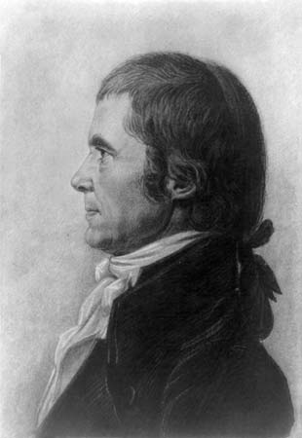
XYZ Affair Origins
Adams sends three commissioners (John Marshall, Charles Pinckney, and Elridge Gerry) to negotiate a peace.
John Marshall
http://cache.eb.com/eb/image?id=97171&rendTypeId=4

Slide 11
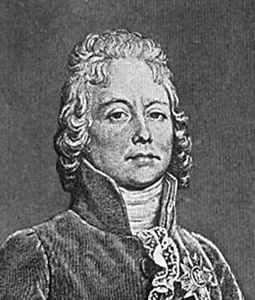
XYZ Affair Talleyrand
French foreign minister.
Sends three agents (known as X, Y, and Z) to demand a huge bribe from the Americans before he would talk with them.
Charles Maurice de Talleyrand
http://www.lofaber.com/embargo/images/talleyrand.jpg

Slide 12
XYZ Affair Talleyrand
The American commissioners refuse and talks break up in April 1798.
American ships and French ships begin to attack each other.
Federalists want Congress to declare war to restore American honor.
"Millions for defense, but not one cent for tribute!"
Adams and the commissioners become national heroes.

Slide 13
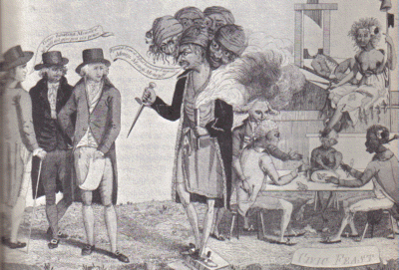
XYZ Affair Talleyrand
American Political Cartoon on the XYZ Affair
http://www.robinsonlibrary.com/america/unitedstates/1783/1789/1797/graphics/xyz.gif

Slide 14
XYZ Affair American Response
Congress ends the French alliance.
Creation of a naval department.
Congress appropriates money to triple the size of the army and build 40 warships.
Washington comes out of retirement to lead the American forces.
American privateers attack French shipping.

Slide 15
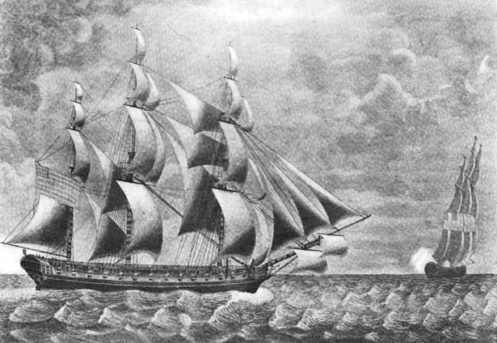
The Alien & Sedition Acts
Aimed at keeping refugees from both sides of the French Revolution from having an influence on the American government, and perhaps more importantly quieting the Dem-Republicans.
American Response to XYZ Affair
http://www.mariner.org/usnavy/images_content/fullsize/05f_E323A42ConstlInsurgente.jpg

Slide 16
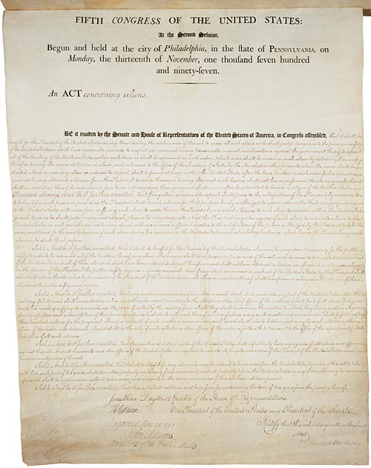
The Alien & Sedition Acts The Alien Acts
Naturalization Act.
Increased the eligibility for citizenship from 5 to 14 years.
Alien Enemies Act.
Gave the President the power to arrest or expel enemies in times of "declared war."
Alien Act.
President can expel all aliens deemed "dangerous to the peace and safety of the United States."
The Alien Act
http://www.historicaldocuments.com/AlienandSeditionActs1.jpg

Slide 17
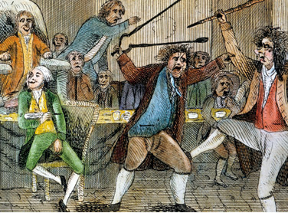
The Alien & Sedition Acts The Sedition Act
Made it a crime to "impede the operation of any law."
Illegal to publish or speak any "false, scandalous, and malicious" criticism of high government officials.
A Fight in Congress
Over the Sedition Act
http://www.apfn.net/MESSAGEBOARD/07-02-04/tjalien.jpg

Slide 18
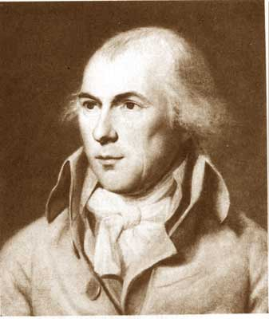
The VA & KY Resolves Jefferson & Madison
Democratic-Republicans believe that the Alien and Sedition Acts violate the First Amendment and were an invasion of states' rights.
James Madison
http://www.ons.uconn.edu/images/james_madison.jpg4

Slide 19
The VA & KY Resolves Virginia & Kentucky Resolves
Drafted by Jefferson (Kentucky) and Madison (Virginia).
Stated the following.
1. The Constitution was a compact
between sovereign states.
2. Each state had "an equal right to judge
for itself" when the Constitution had
been violated.
3. IMPORTANT: A state can declare a law
of Congress unconstitutional.

Slide 20
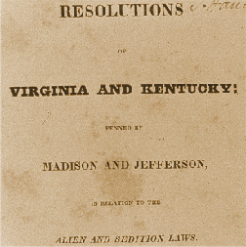
The VA & KY Resolves Virginia & Kentucky Resolves
Immediate impact was little, with neither state doing anything substantial.
Would set a precedent for sectionalism and the states' rights debate later.
Threatened Federalist authority, who did nothing about it.
VA & KY Resolutions
http://www.jmu.edu/madison/center/images/resolutions.gif

Slide 21
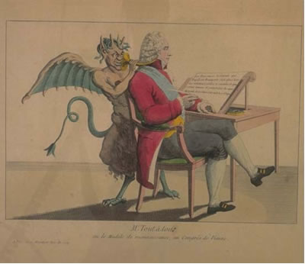
France Capitulates
Talleyrand does not want war with the United States.
Already struggling with no allies.
Does not want to add another enemy.
Will accept new negotiators without a bribe.
Talleyrand and the Devil
http://www.wlym.com/~animations/ceres/Images/talleyrand_devil.jpg

Slide 22
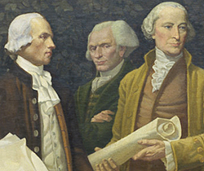
France Capitulates
Hamilton and Federalists still want war.
Will go to war with France, but if Spain is available, we'll take them.
Spain was weak.
Spain controlled Florida, New Orleans, and Louisiana.
3. Spain cut off trade for the Mississippi.
Federalist Leaders
http://www.archives.gov/publications/prologue/2006/spring/images/mural-detail-m.jpg

Slide 23
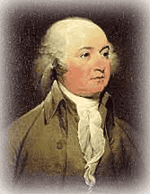
France Capitulates
Adams remains cool.
Sends ministers to France and Spain to negotiate treaties.
Infuriates some of the Federalists, who withdraw some support in the next election.
John Adams
http://www.u-s-history.com/images/john-adams.gif

Slide 24
Question 1
The Virginia and Kentucky Resolutions argued that the right to determine the constitutionality of a law passed by Congress rested in
A. Congress.
B. the states.
C. the President.
D. the Supreme Court.
E. the vote of the common people.

Slide 25
Question 2
The XYZ Affair resulted in
A. the growth of pro-French sentiment in
the United States.
B. a formal alliance between Great Britain
and the United States.
C. an undeclared war between the United States and France.
D. embarrassment for President Adams.
E. a new alliance with France against Great Britain.

